Slide 1
All Your Heatmap Are Belong To Us - Building an Adversary Behavior Sighting Ecosystem
Richard Struse
Chief Strategist, Cyber Threat Intelligence

Slide 2
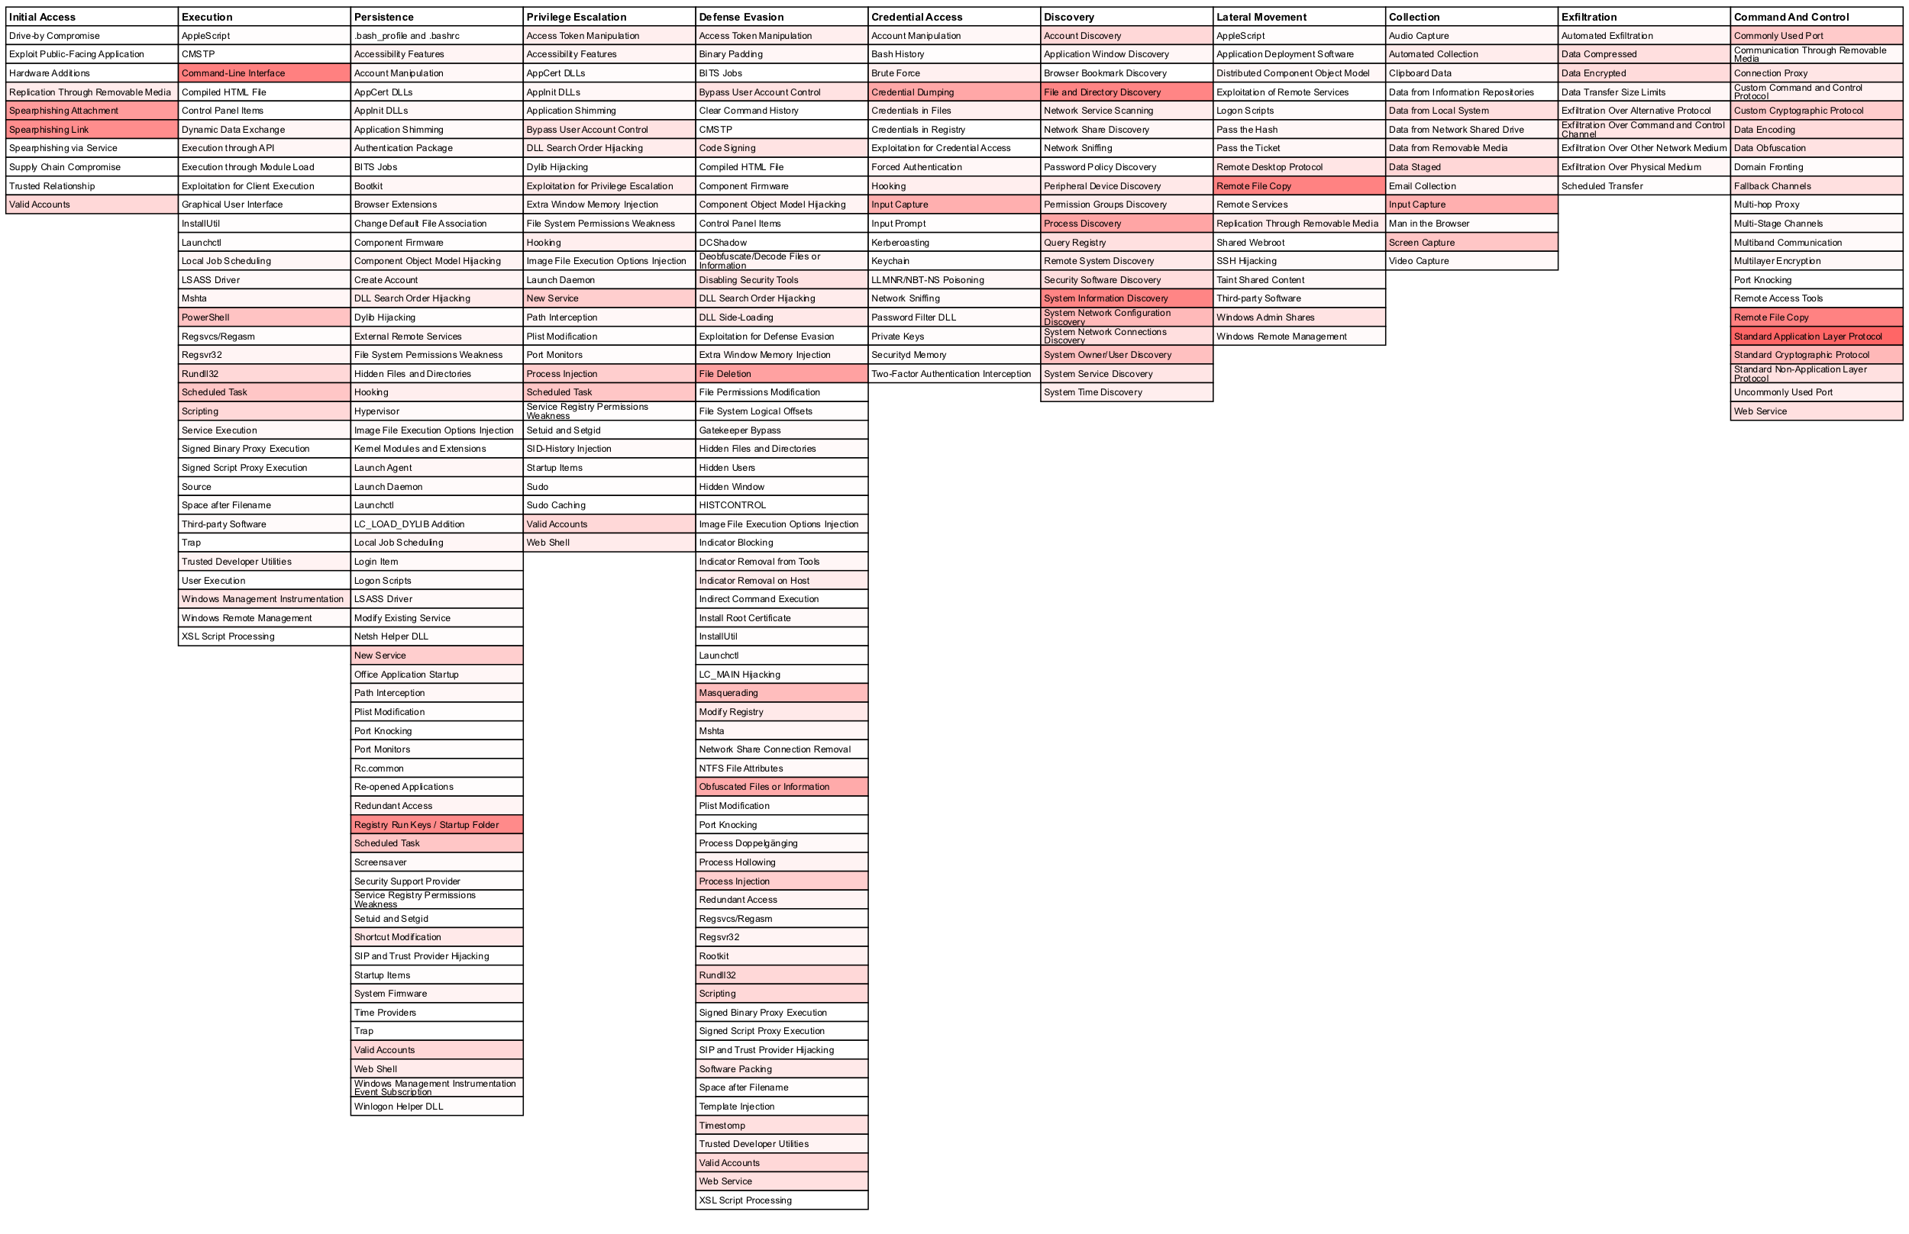
BLUF
General Goal: Empower the broadest possible community with real data about adversary behavior.
More specifically: Use anonymized reported sightings of adversary behavior to enable this type of frequency heatmap (and much more)
Note: All heatmaps in this presentation are notional

Slide 3

What do we mean by “Adversary Behavior”?
Tactics, techniques & procedures of cyber adversaries
For our purposes, techniques as defined in the MITRE ATT&CK™ framework
ATT&CK™ is a globally-accessible knowledge base of adversary tactics and techniques, developed by MITRE based on real-world observations of adversaries’ operations.
ATT&CK™ is increasingly being used by the community as a common way to describe adversary behavior.
attack.mitre.org

Slide 4
What do we mean by “Sightings”?
A detection of specific adversary behavior as defined within ATT&CK
Three sub-types, in decreasing order of priority/interest:
Direct sighting of adversary behavior
Direct sighting of malicious software
Indirect sighting of malicious software
Examples:
At 2019-01-01T08:12:00Z, ATT&CK Technique T1088 was detected in the US Financial Sector
At 2019-01-01T08:12:00Z, software capable of ATT&CK Technique T1088 was detected in the US Financial Sector
At 2019-01-01T08:12:00Z, software capable of ATT&CK Technique T1088 was reported in a threat-intel platform

Slide 5
Some of the questions we’d like to answer
What techniques are being detected in the wild?
Are there differences in detections across different sectors?
Are there differences in detections across geographical boundaries?
How do the detections change over time?
Why are they changing?
What impact are our defensive improvements having?
Extra credit: What adversaries are using what behaviors (attribution)

Slide 6
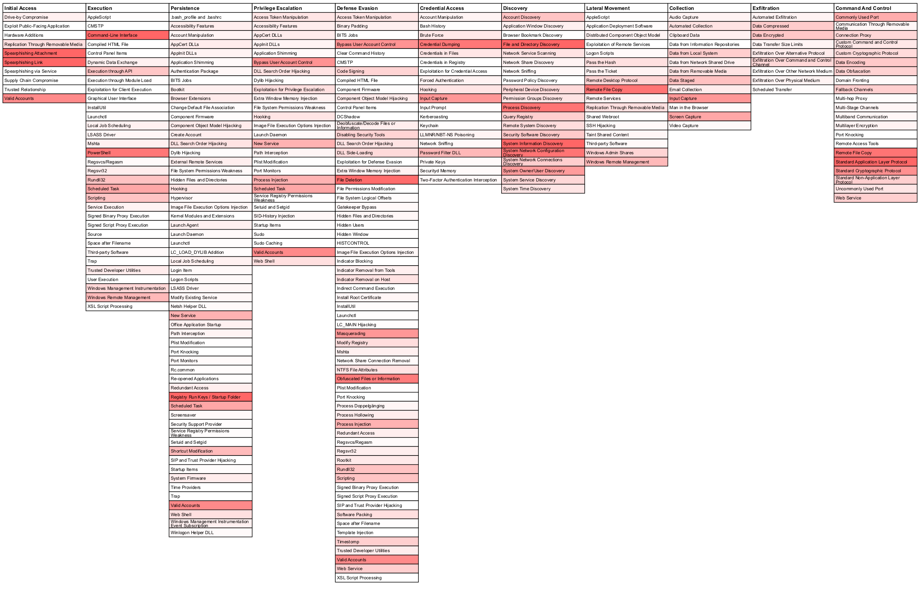
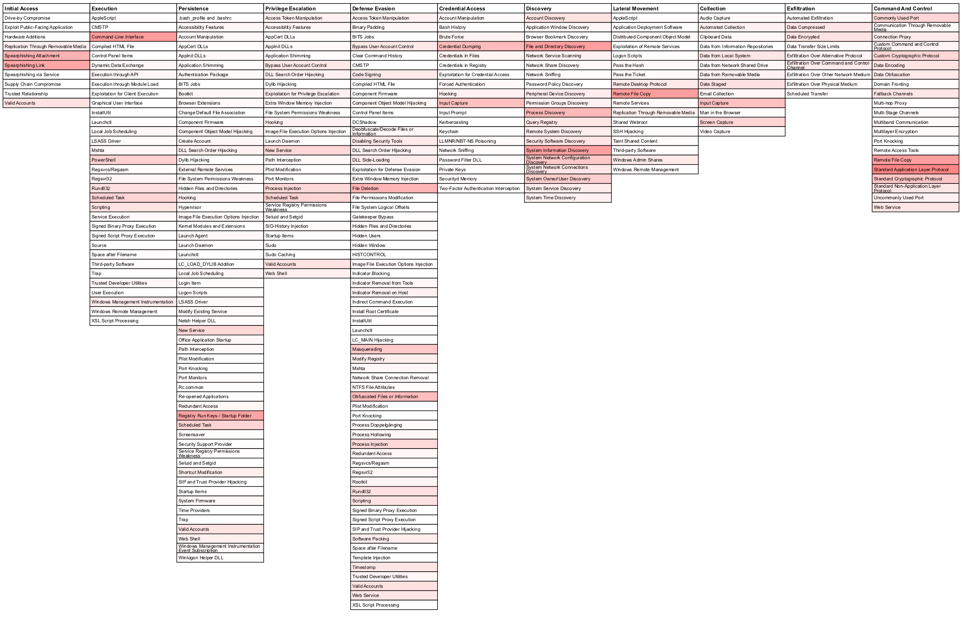
Use case: Comparing Different Sectors
Healthcare
Financial
Manufacturing

Slide 7
Use case: Studying trends over time
Time

Slide 8
Questions we are not asking…
What were the organizations where the behavior was detected?
Was the adversary successful?
What was the impact of the behavior?
How was the behavior detected?
This is not an incident reporting mechanism!

Slide 9





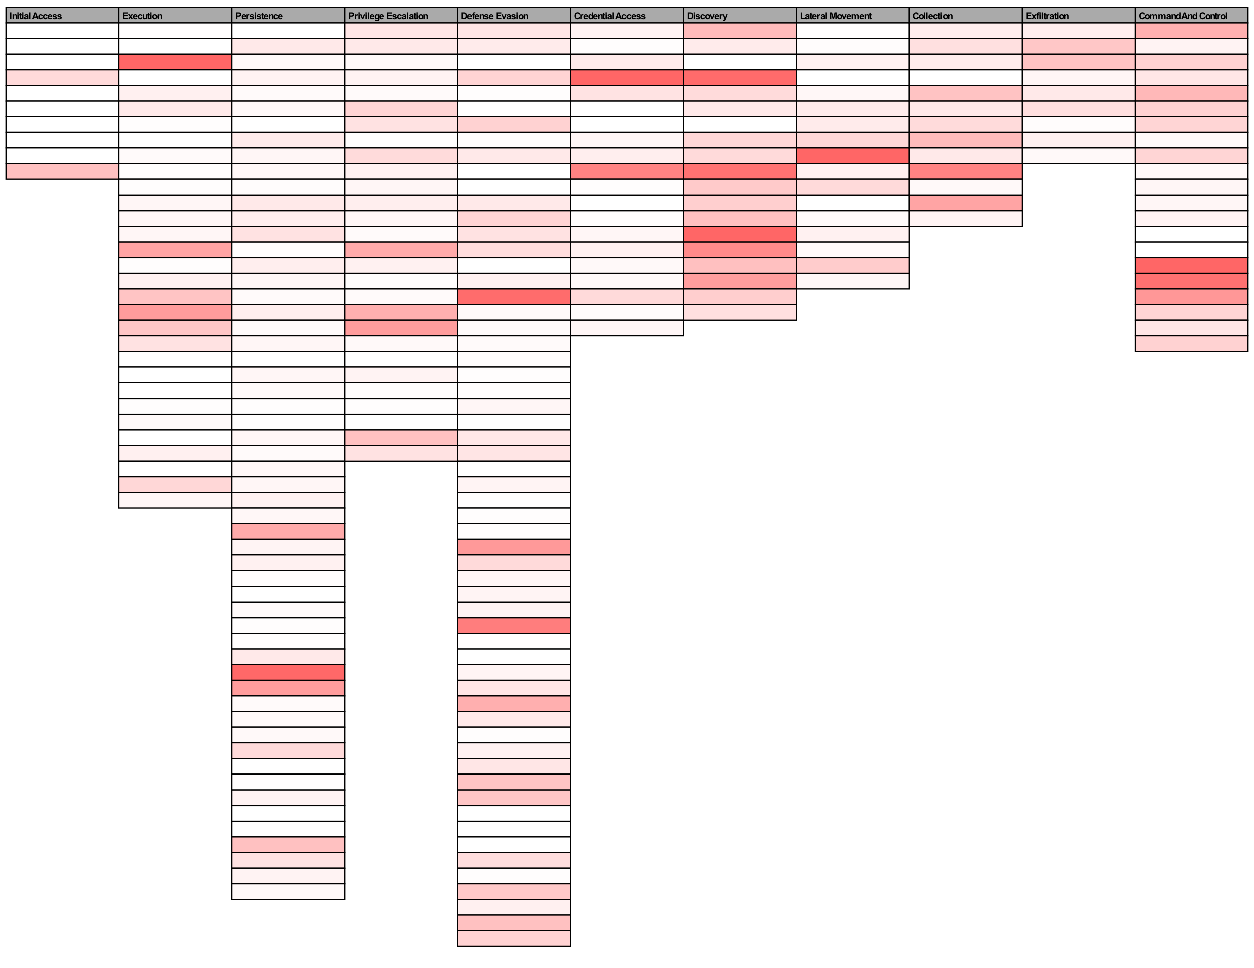
Vision of Desired End-State
Security product & service vendors
Continuously updated telemetry on what adversaries are actually doing
ISACs & ISAOs
MSSPs & ISPs
Anonymized
Potentially aggregated
Detections
Sightings

Slide 10
How do we get there?
Propose a (simple) mechanism for reporting sightings
Collaborate with potential reporters of sightings to define/refine the approach
Conduct some experiments (under NDA)

Slide 11
Barriers/Limitations/Caveats
Availability of accurate detection of adversary behavior mapped to ATT&CK techniques
Willingness to share the data
Differing interpretations of behavior across reporting organizations
The usual data quality issues
Biases, biases, biases…

Slide 12
Potential uses of this data
Help ISACs and ISAOs help their members build sector-specific threat models informed by this data
Help security teams prioritize their efforts to close gaps in their defenses
Help underwriters of cyber insurance identify the most crucial adversary behaviors
What would you do with this sort of data?

Slide 13
Roadmap
Pilot Phase
Propose a notional sighting report data format
Iterate with potential reporting orgs on format
Execute NDA for trial submission period
Accept submissions of sightings data from multiple reporters
Initial Operation
Execute agreements to allow publication of aggregated sightings
Accept initial production submissions
Initial publication
Maturation
Data format frozen, automated submission mechanism operational

Slide 14
Getting Involved
Read John Wunder’s blog post: https://medium.com/mitre-attack/building-an-attack-sightings-ecosystem-b43d52cac151
Review the details at: https://attack.mitre.org/resources/sightings
Help us make this better – give us your comments and suggestions
If you’re interested in contributing, email attack@mitre.org or talk to me after this presentation

Slide 15
Questions for the MITRE ATT&CK™ community

Slide 16
Raise your hand if the item interests you
Develop open-source NLP tool to extract ATT&CK tactics and techniques from prose documents
Contribute data (or analytics) to an adversary sighting ecosystem project
Develop an open-source federated repository for ATT&CK data (using STIX2/TAXII2)
Learning how to proactively map threat-intel to ATT&CK
Collaborate to develop sector-specific threat models (subsets of ATT&CK + technique prioritization)
Automated extraction of ATT&CK tactics/techniques from malware samples via static and/or dynamic analysis

Slide 17
Questions?
Thank You!

